Slide 1
Programming Fundamentals
Lecture 21

Slide 2
Objectives
Overloading of stream insertion (<<) and stream extraction (>>) operators
UML Class Diagrams
Access Specifiers

Slide 3
Overloading of Stream Operators
In C++, stream insertion operator “<<” is used for output and extraction operator “>>” is used for input
We must know following things before we start overloading these operators
  cout is an object of ostream class and cin is an object istream class
  These operators must be overloaded as a global function
  And if we want to allow them to access private data members of class, we must make them friend

Slide 4
Why Streams Operators Must be Overloaded as Global?
In operator overloading, if an operator is overloaded as member, then it must be a member of the object on left side of the operator
  For example, consider the statement “ob1 + ob2” (let ob1 and ob2 be objects of two different classes). To make this statement compile, we must overload ‘+’ in class of ‘ob1’ or make ‘+’ a global function
The operators ‘<<' and '>>' are called like 'cout << ob1' and 'cin >> ob1’
So if we want to make them a member method, then they must be made members of ostream and istream classes, which is not a good option
Therefore, these operators are overloaded as global functions with two parameters, cout and object of user defined class

Slide 5
Overloading of << Operator
Declaration
friend ostream & operator << (ostream &, class_name &);
Definition
ostream & operator << (ostream & cout, class_name &obj_name)
{
//display object attributes
return cout;
}

Slide 6
Overloading of >> Operator
Declaration
friend istream & operator >> (istream &, class_name &);
Definition
istream & operator >> (istream & cin, class_name &obj_name)
{
//use cin to ask the user to enter object attributes
return cin;
}

Slide 7
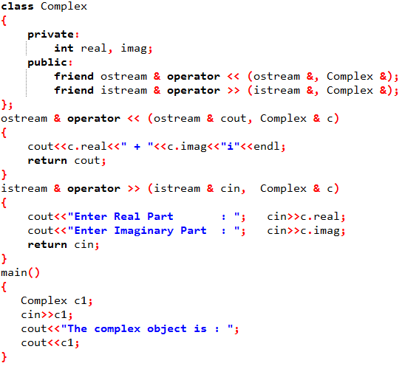
Example 1

Slide 8
Practice Problem 1
Write a program by using the concepts of OOP and operator overloading to design a distance calculator.
Your program must be able to add, subtract and compare two distances.
Ask the user to enter the feet and inches for two distances, and then ask the user to enter a character and depending on the character add, subtract or compare the distances
And finally show the two distances and their result
You need to overload >>, <<, +, -, >, < and == operators

Slide 9
UML Class Diagram
A class diagram in the Unified Modeling Language (UML) is a type of static structure diagram that describes the structure of a system by showing the system's classes, their attributes, operations (or methods), and the relationships among objects
The purpose of UML is to provide a standard way to visualize the design of a system
UML is not a development method by itself however it helps us to develop the programs

Slide 10
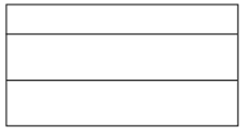


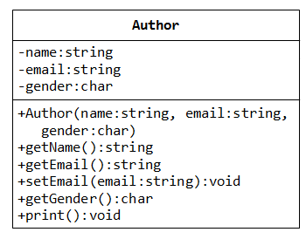
UML Class Diagram
In the diagram, classes are represented with boxes that contain three compartments
  The top compartment contains the name of the class. It is printed in bold and centered, and the first letter is capitalized
  The middle compartment contains the attributes of the class. They are left-aligned and the first letter is lowercase
  The bottom compartment contains the operations the class can execute. They are also left-aligned and the first letter is lowercase

Slide 11
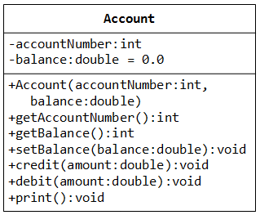
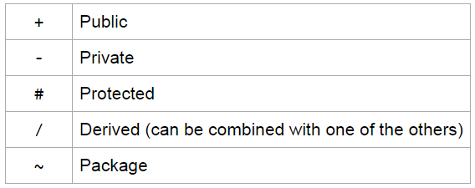
UML Class Diagram
UML provides mechanisms to represent class members, such as attributes and methods, and additional information about them
To specify the visibility of a class member (i.e. any attribute or method), these notations must be placed before the member's name

Slide 12
Access Specifier
Access specifiers (or access modifiers) are keywords in object-oriented languages that set the accessibility of classes, attributes, methods, and other members
There are 3 access specifiers in C++
Private, Public and Protected
Access Specifier | Accessible From Objects of own Class | Accessible From Objects of derived Class | Accessible From Objects outside
Private | Yes | No | No
Public | Yes | Yes | Yes
Protected | Yes | Yes | No

